Slide 1
MLAI for Infrastructure: Climate Hazards
Alison Peard
Intelligent Earth CDT, 13th December 2024
Notes:
Intro (3 mins)
Fundamentals (7 mins)
Mapping vs cat models (8 mins)
DL applications (8 mins)

Slide 2
Lecture structure (30 mins)
Introduction (3 mins)
Hazard Modelling Fundamentals (6 mins)
Compound Hazards (3 mins)
Hazard Mapping and Catastrophe Modelling (7 mins)
Deep Learning Applications (7 mins)
Conclusion and Future Directions (4 mins)

Slide 3
Introduction

Slide 4
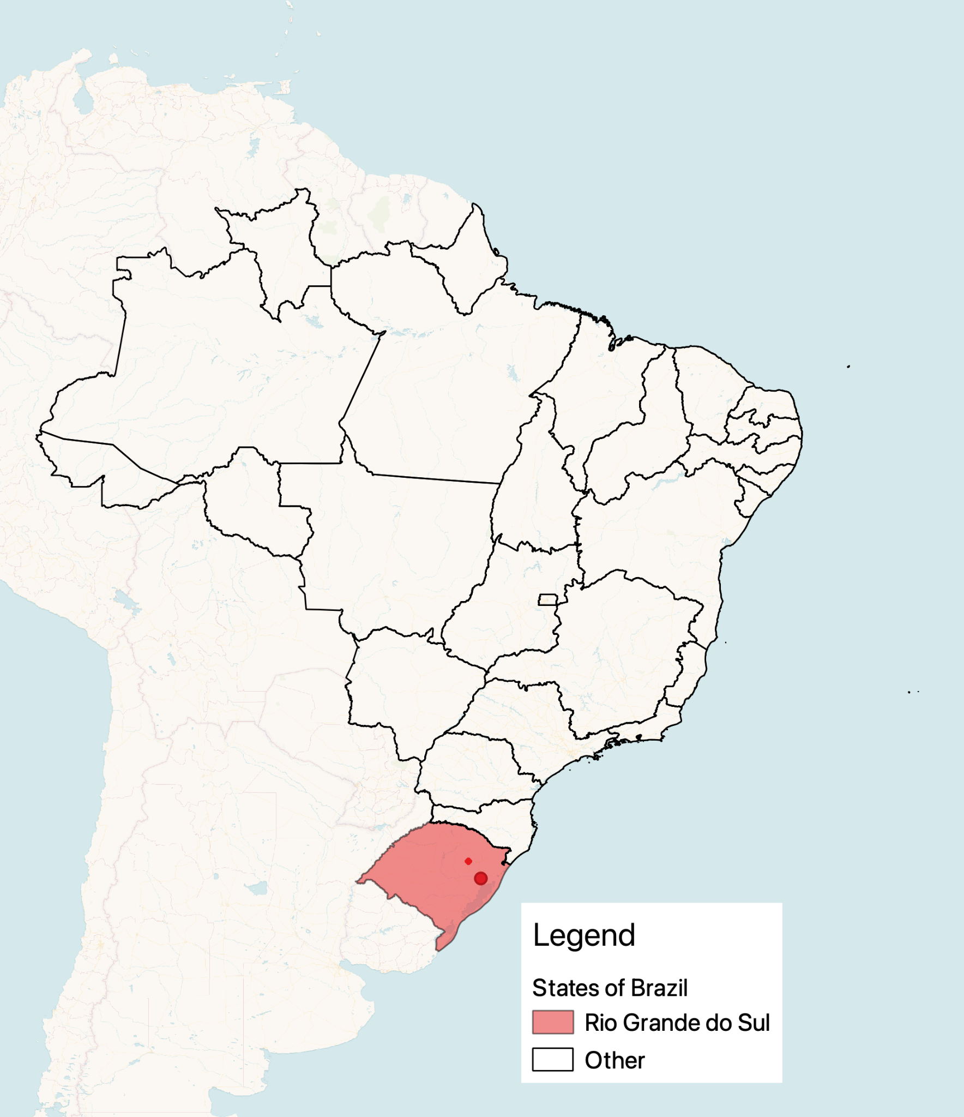
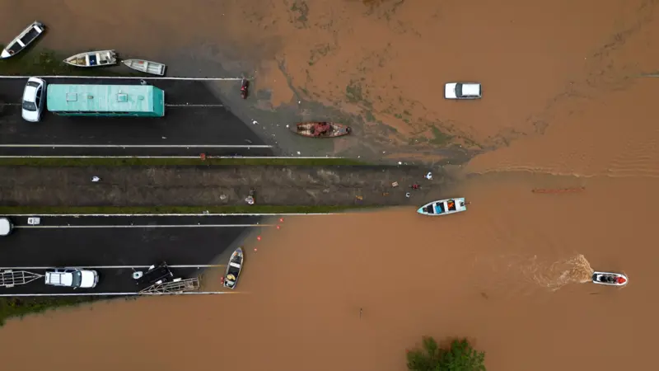
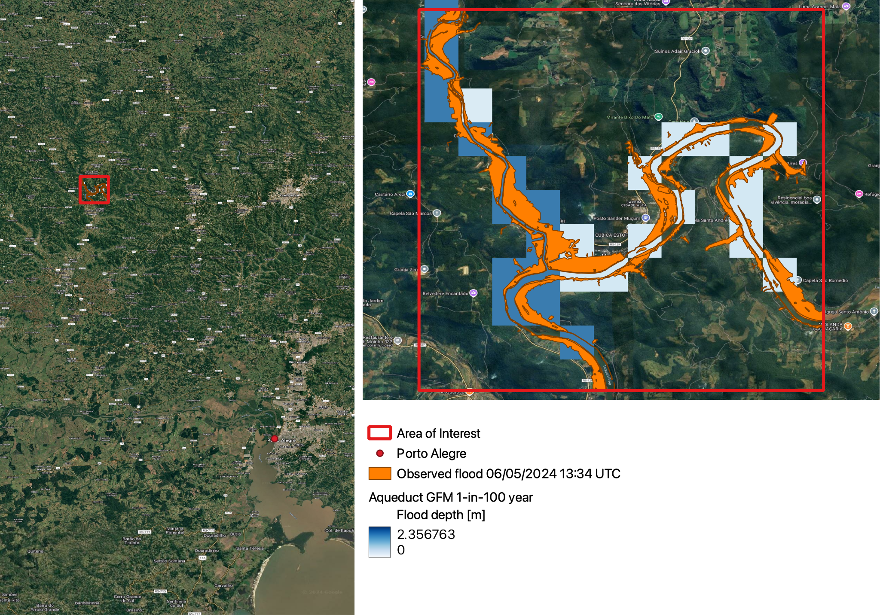




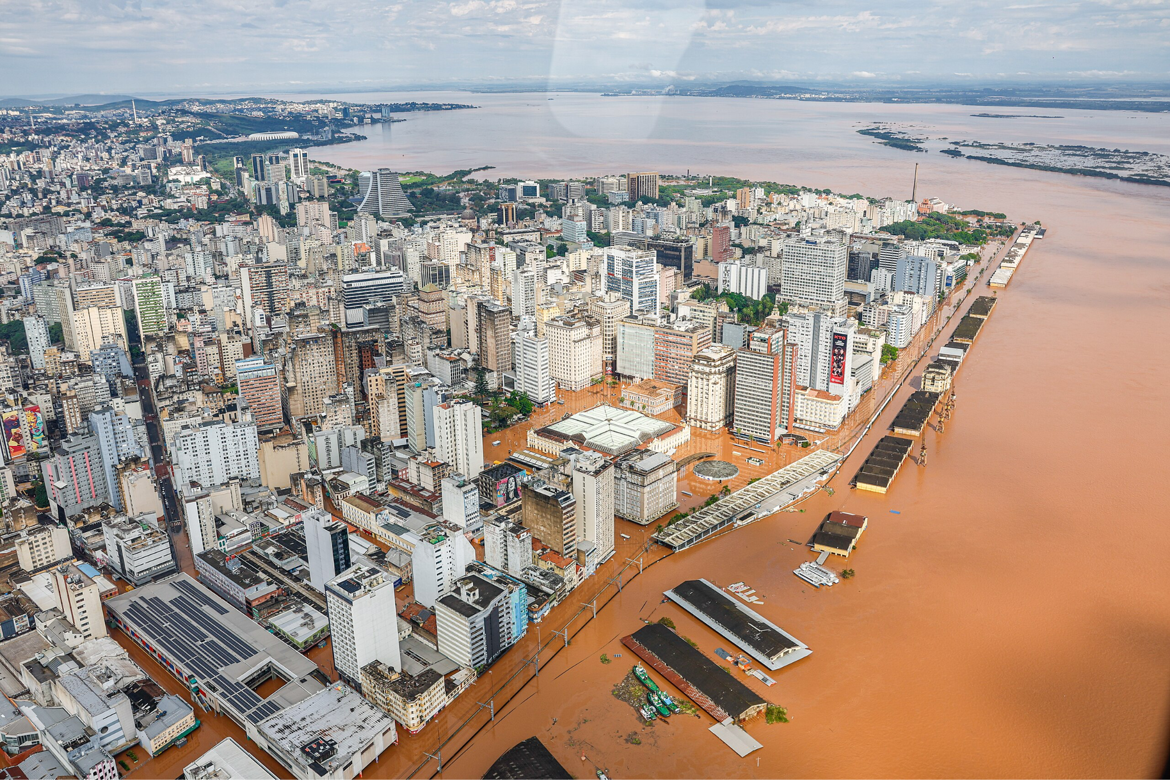

Introduction 2024 Rio Grande do Sul floods
Extreme rainfall in April-May
Caused landslides and flooding
181 dead
809⁺ injured
580,000 displaced
BBC Brasil
CMS Rapid Mapping + Aqueduct 100-yr flood
$3.7 billion damages
500,000 people without power or clean water
BBC Brasil
Flood defence deterioration and poor land-use policies contributed to damage extent
Porte Alegre flooded, Wikipedia
https://rapidmapping.emergency.copernicus.eu/EMSR720/reporting
Notes:
In April and May this year there was disastrous flooding in the south of Brazil
In the state’s capital, Porte Alegre, the average rainfall during the first twelve days of May was three times the monthly average
Leading to extreme flooding and landslides
There were widespread societal effects
181 casualties and over 809 injuries
Over 580,000 displaced
$3.7 billion in damages
500,000 people lost access to power or clean water
Govt criticised for extent of damages including
Neglect of flood defence infrastructure such as flood walls
Reducing funds for disaster risk management
Changing land-use policies to allow development of natural floodplains
Hazard modelling allows us to estimate what regions are at highest risk from climate hazards
For example, here is an Aqueduct global flood hazard map (in blue) for an area North of Porto Alegre
In this case, the map is okay, (river flood plain) however resolution is coarse
The better the hazard maps the better we can prepare for future possible climate hazards
------------------------------------------------------------------------------------------------------------------------------------------------------------------------
Description
In April and May this year there was disastrous flooding in the south of Brazil
the Brazilian State of Rio Grande do Sul was hit by extreme rainfall over a very short period
In the state’s capital, Porte Alegre, the average rainfall during the first twelve days of May was three times the monthly average
From the beginning of May the Guaíbi river in the State’s capital Porto Alegre was over 5m above its normal level
Area the size of northern France was flooded (check)
Landslides
Adaptation
Early warning systems worked and large humanitarian response including army, navy, firefighters, and police
Government neglect and policies blamed for extent of damages including
Intensive land use policies and building on floodable lands (9/04/2024)
Decrease in federal funds for risk management and disaster response R$7.8 billion in 2014 (inflation-adjusted) to R$2.6 billion in 2024.
In Porto Alegre, neglect was blamed for the rupture of one of the city flood wall’s gates, built to withstand 6m flooding but ruptured at 4.5m
More factors
Moist air travels South over the Amazon rainforest “The flying river”
Global warming ⇒ air can hold more moisture ⇒ heavier rains

Slide 5
Hazard Modelling Fundamentals

Slide 6


Hazard Modelling Fundamentals Core objectives vs climate modelling
Climate Modelling
Hazard modelling
Focus
Physical processes and Earth System dynamics
Extreme events and their impacts
Key Users
Scientists and policymakers
Insurers, engineers, governments
Timeframe
Decades to centuries
Event-based or probabilities
Priority
Scientific accuracy and completeness
Practical utility and loss estimation
Notes:
Climate Modeling:
Scientific understanding
Focus on physical processes and interactions
Aims to represent Earth system dynamics completely
Emphasis on global patterns and long-term trends
Temporal priorities
Long-term projections (decades to centuries)
Seasonal to annual variations
Climate change impacts
Success metrics
Scientific accuracy and completeness
Model validation against observations
Ability to reproduce known climate phenomena
Hazard Modeling:
Risk assessment and mitigation
Focus on extreme events and their impacts
Aims to quantify potential losses
Emphasis on local to regional scales
Temporal priorities
Return periods of extreme events
Short-term event forecasting
Immediate decision support
Success metrics
Financial loss estimation accuracy
Actionable insights for stakeholders
Regulatory compliance (e.g., insurance requirements)
Key Contrasts to Emphasize:
Primary Users
Climate: Scientists and policymakers
Hazard: Insurers, engineers, emergency managers
Model Requirements
Climate: Physical consistency is paramount
Hazard: Practical utility and fast computation
Uncertainty Treatment
Climate: Focus on scenario uncertainty
Hazard: Focus on impact uncertainty and financial risk
Would you like me to expand on any of these points or add more specific examples?

Slide 7



Hazard Modelling Fundamentals Key stakeholders
Emergency Services
Expected event severities and worst case scenarios
Insurers
Statistics of potential losses
NGOs
Hotspots for adaptation
Government
Probability, severity, and locations of potential damages and losses

Slide 8
Hazard Modelling Fundamentals Key terms and concepts
Return period
Risk profile/curve
Event footprint
Hazard map
Notes:
Return period
Risk profile
Event footprint
Compound hazards
Hazard maps
Catastrophe models

Slide 9
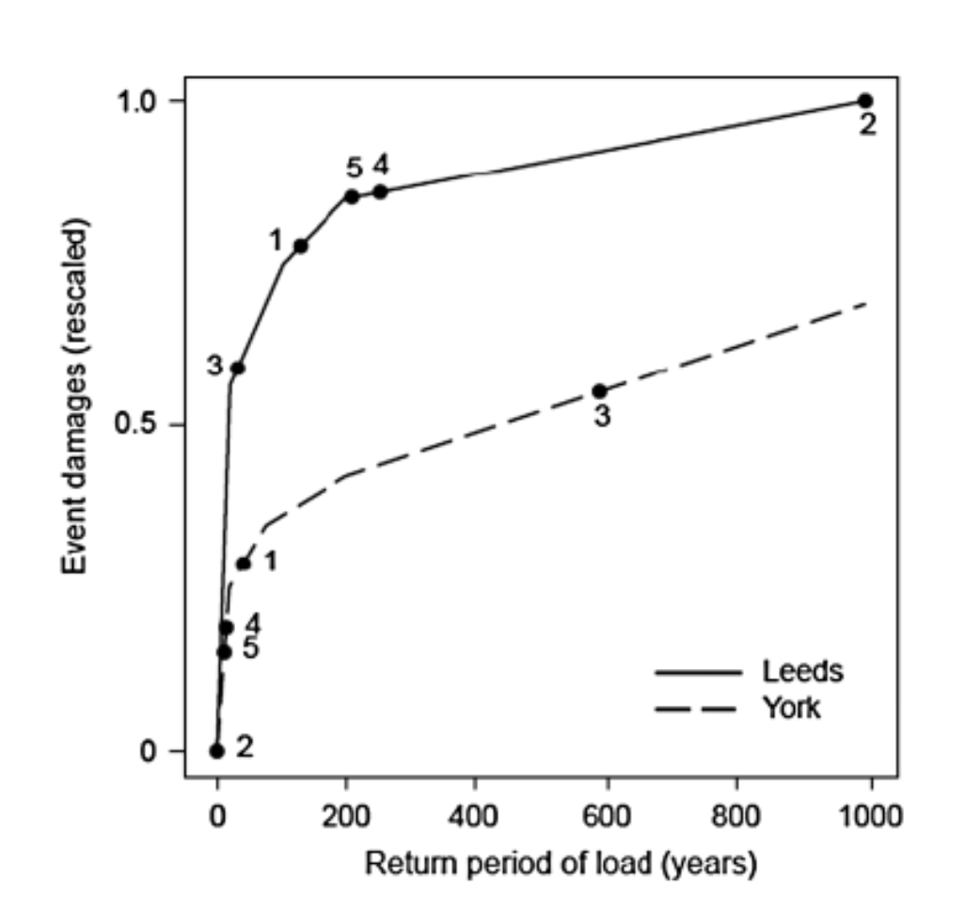
Hazard Modelling Fundamentals Key terms and concepts
Return period
Risk profile/curve
Event footprint
Hazard map
Lamb, R., Keef, C., Tawn, J., Laeger, S., Meadowcroft, I., Surendran, S., ... & Batstone, C. (2010). A new method to assess the risk of local and widespread flooding on rivers and coasts. Journal of Flood Risk Management, 3(4), 323-336.
Notes:
Return period
Risk profile
Event footprint
Compound hazards
Hazard maps
Catastrophe models

Slide 10
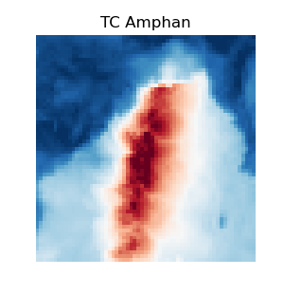
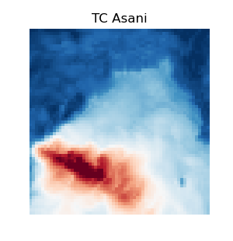
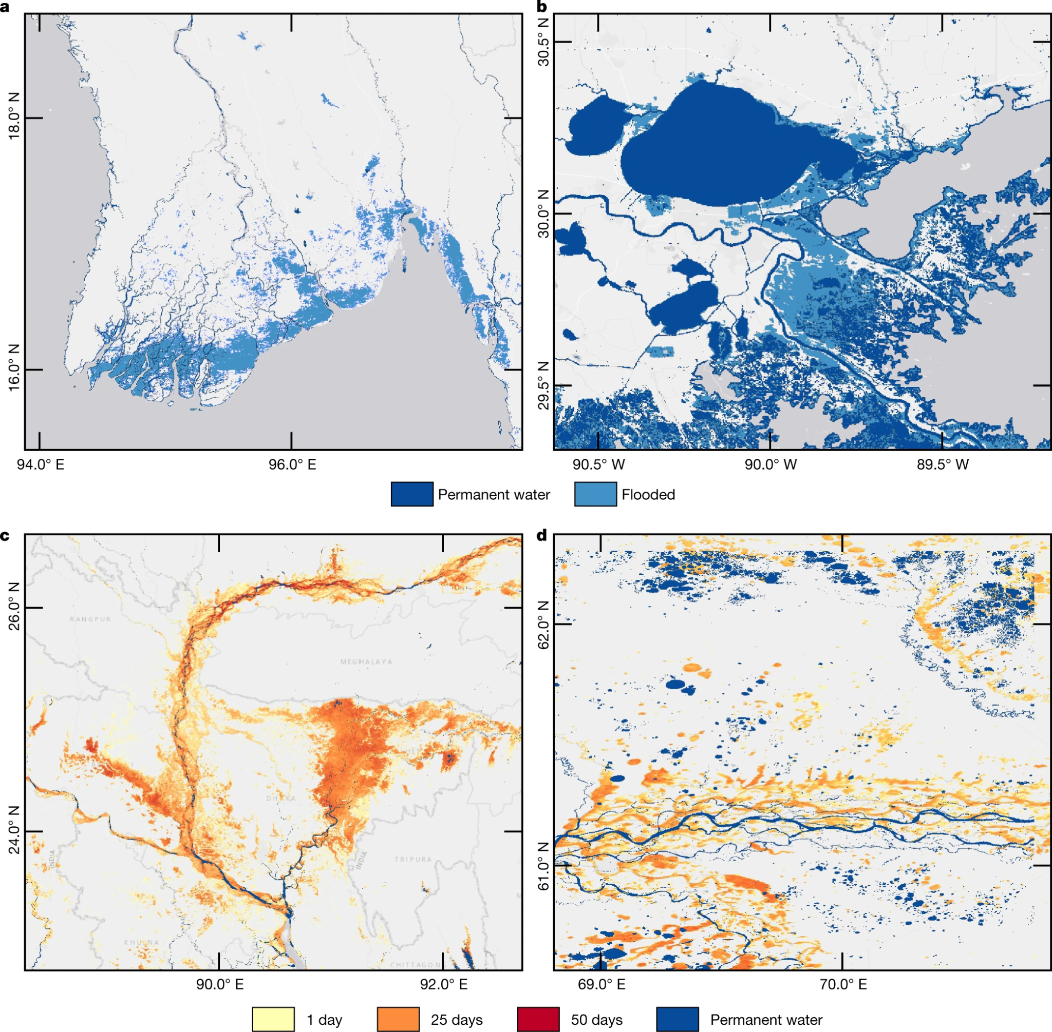
Hazard Modelling Fundamentals Key terms and concepts
Return period
Risk profile
Event footprint
Hazard map
Notes:
Return period
Risk profile
Event footprint
Compound hazards
Hazard maps
Catastrophe models

Slide 11
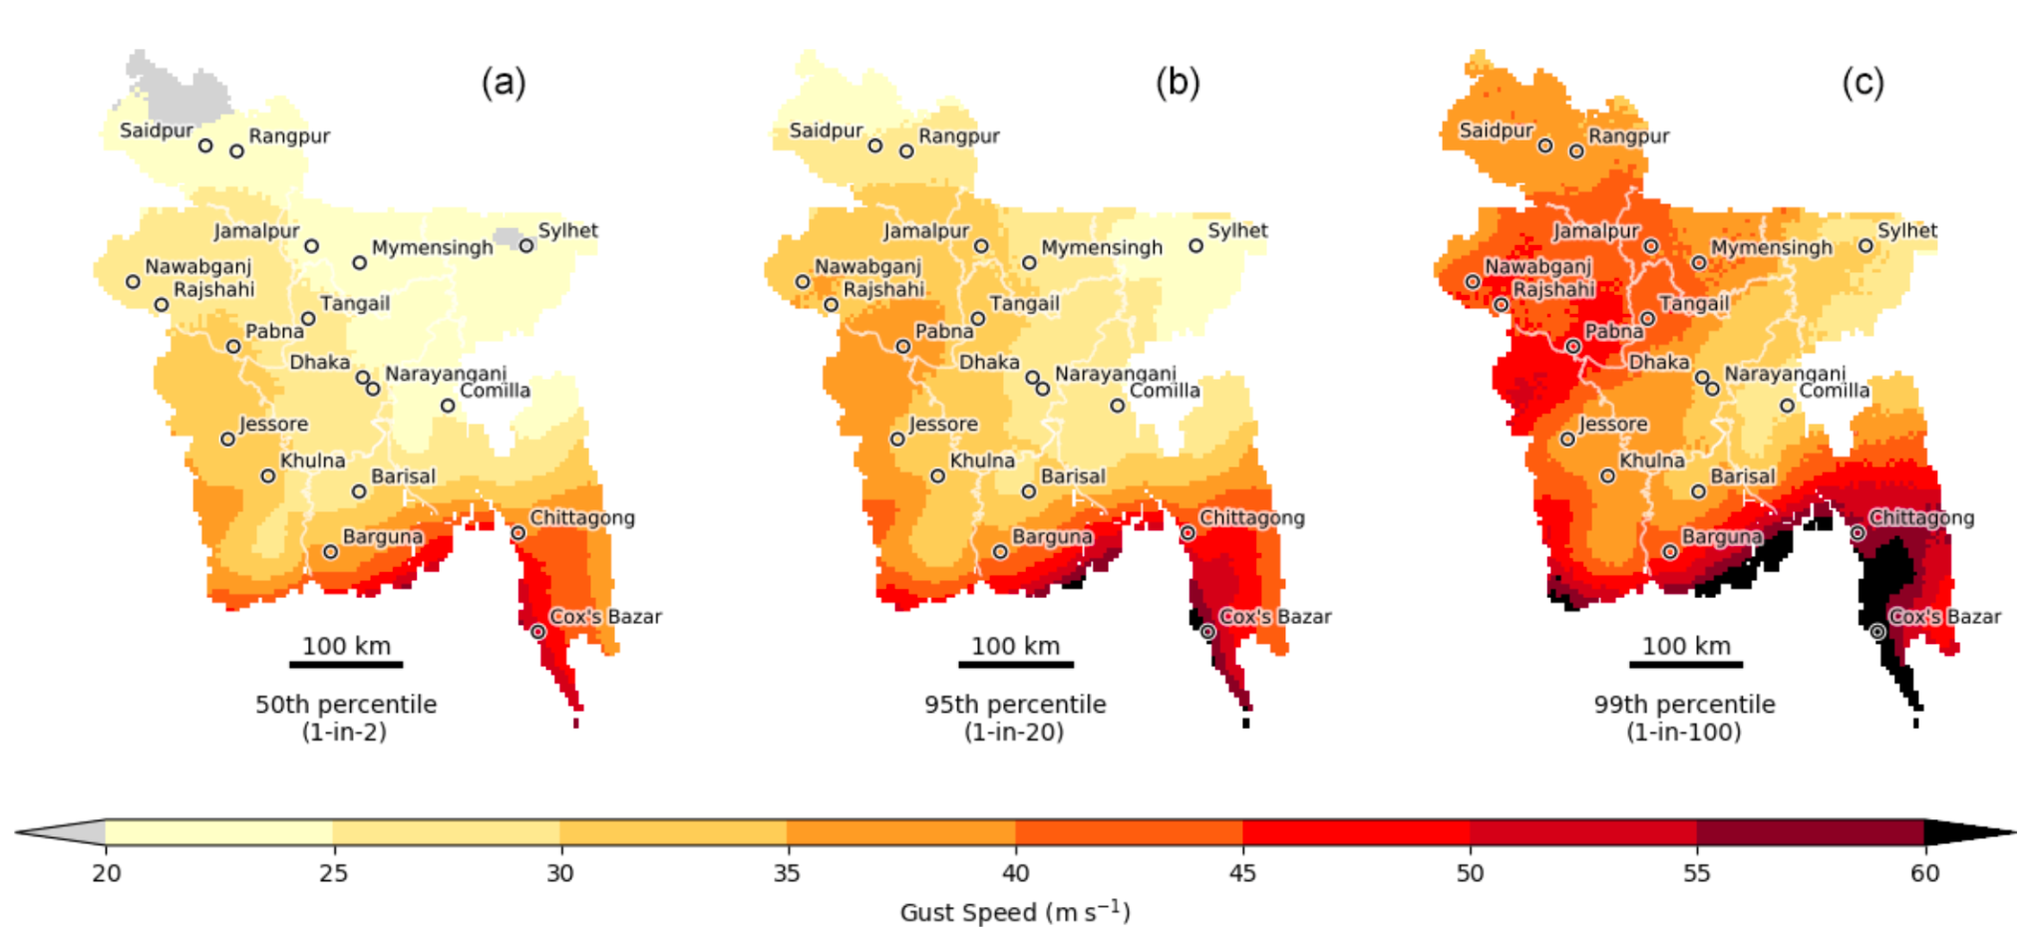
Hazard Modelling Fundamentals Key terms and concepts
Return period
Risk profile
Event footprint
Hazard map
Steptoe, H., & Economou, T. (2021). Extreme wind return periods from tropical cyclones in Bangladesh: insights from a high-resolution convection-permitting numerical model. Natural Hazards and Earth System Sciences, 21(4), 1313-1322.
Notes:
Return period
Risk profile
Event footprint
Compound hazards
Hazard maps
Catastrophe models

Slide 12
Hazard Mapping and Catastrophe Modelling

Slide 13
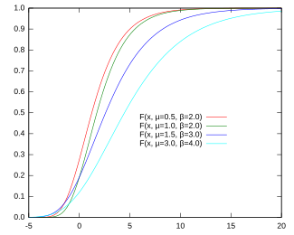
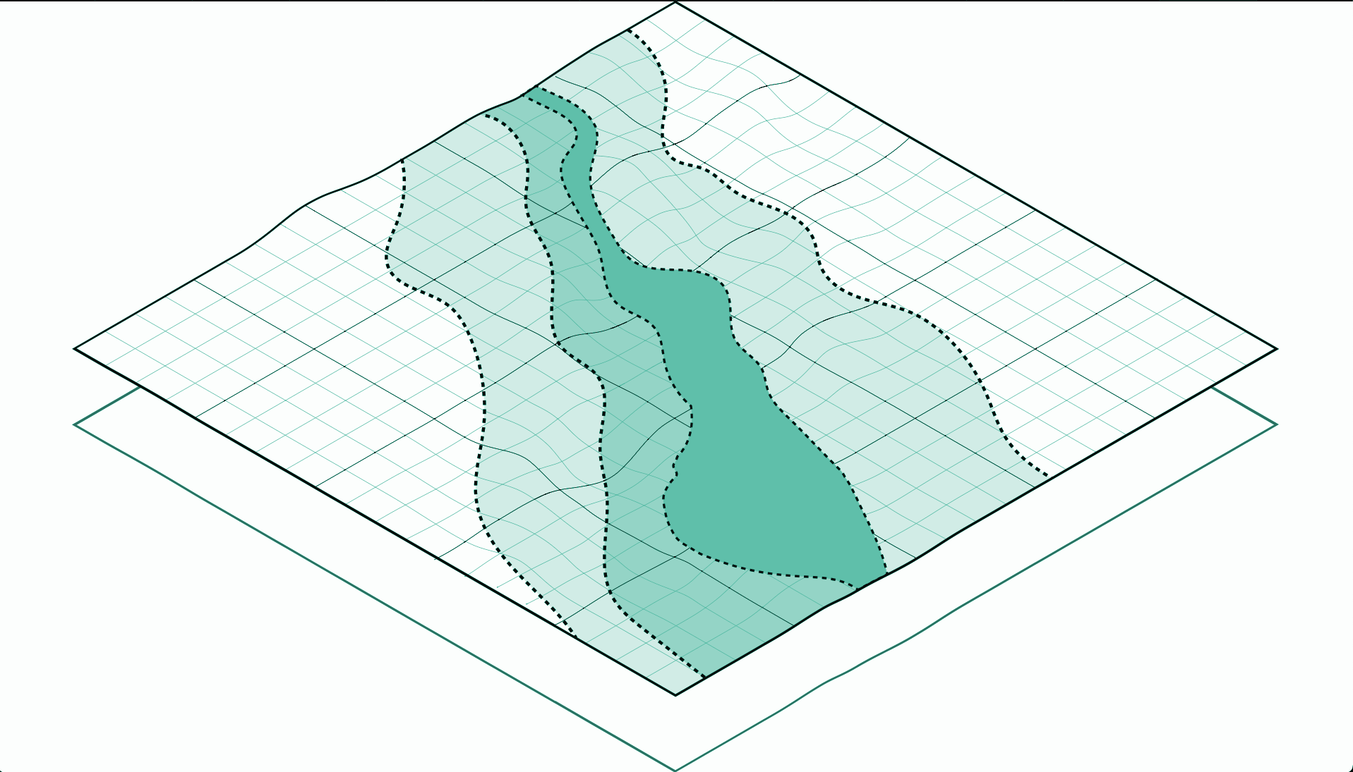
Mapping and Catastrophe Modelling Hazard maps
Features
Probabilistic: one map per return period
Lightweight and efficient
Easy to interpret
No compound effects
Univariate
Spatial independence
Atemporal
CMS Rapid Mapping + Aqueduct 100-yr flood
Notes:
Add figure of a hazard map
Add distribution over single pixel x 3

Slide 14
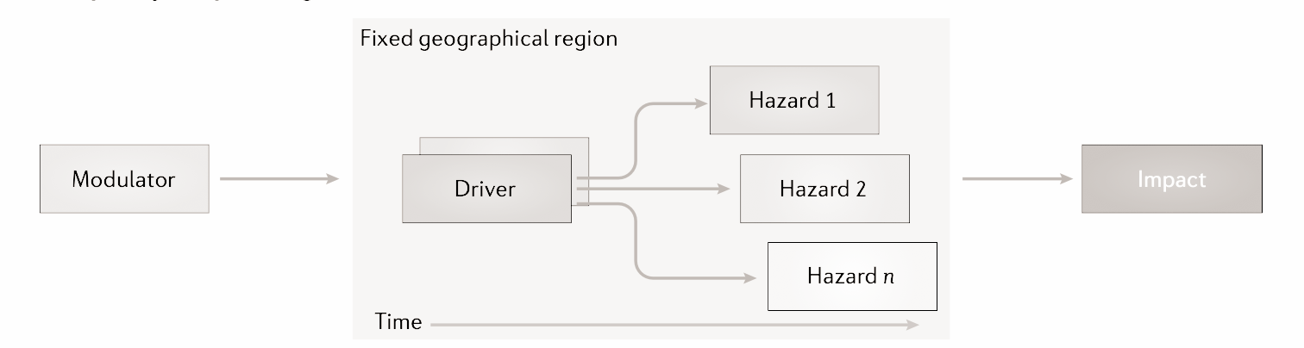
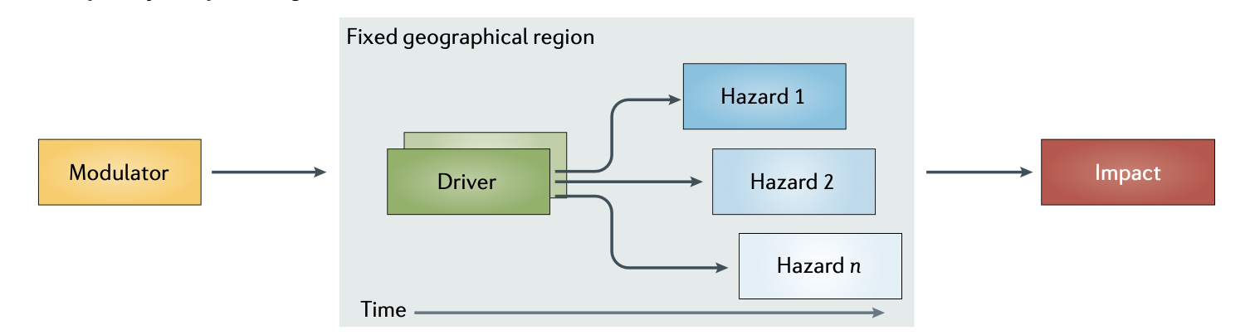
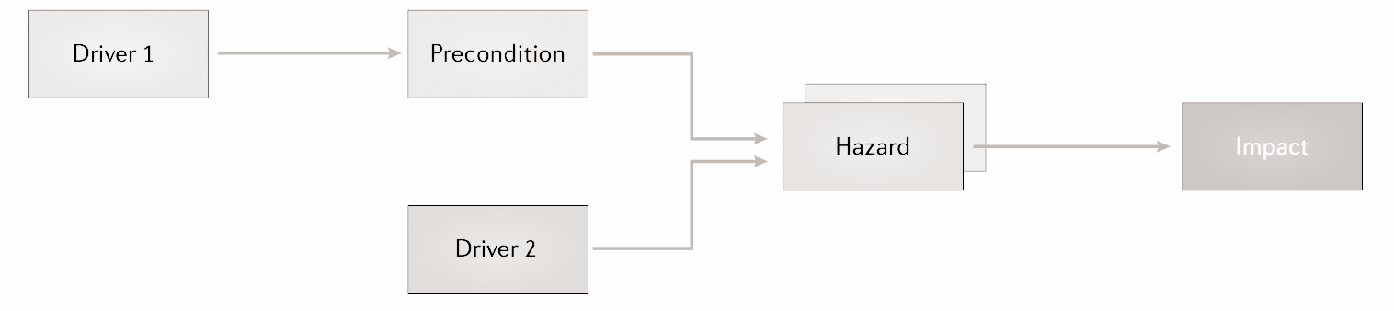
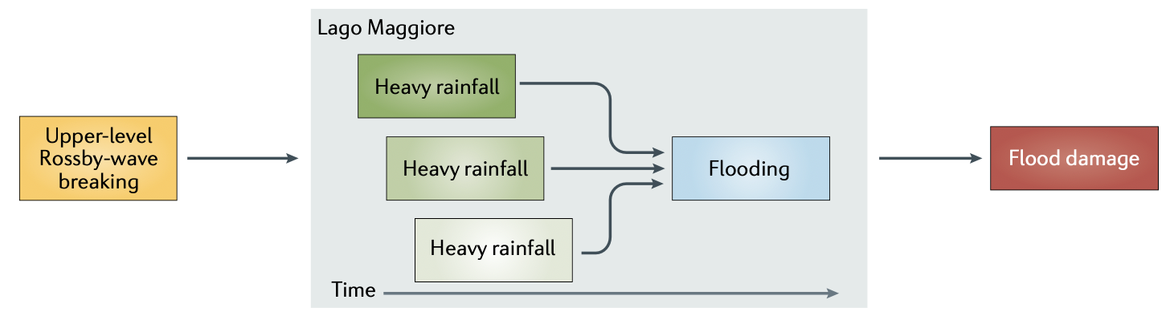
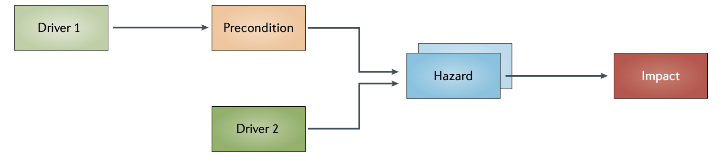
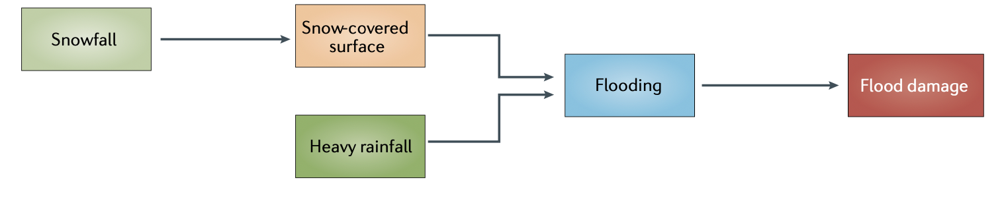
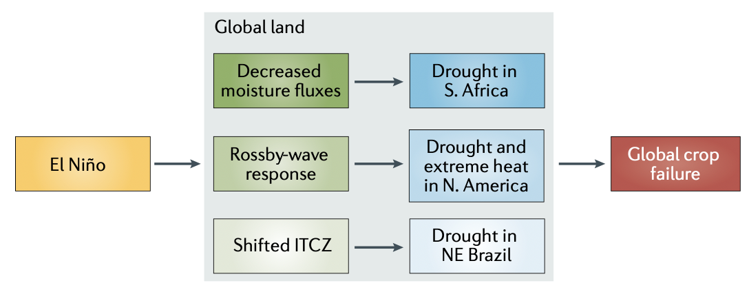
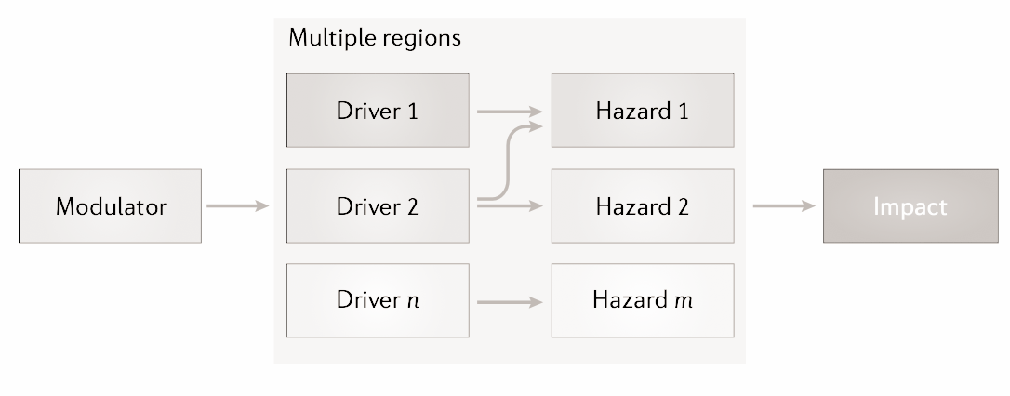
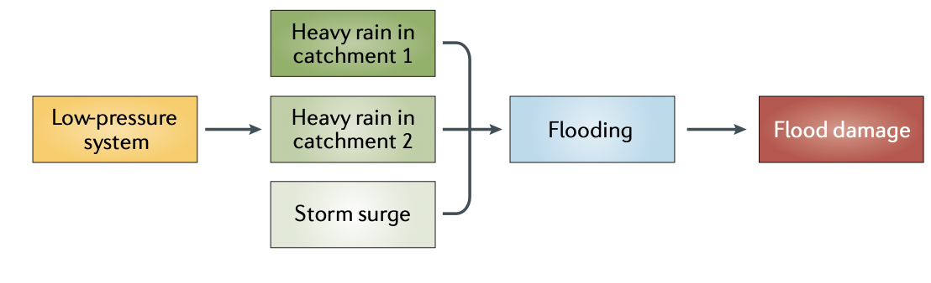
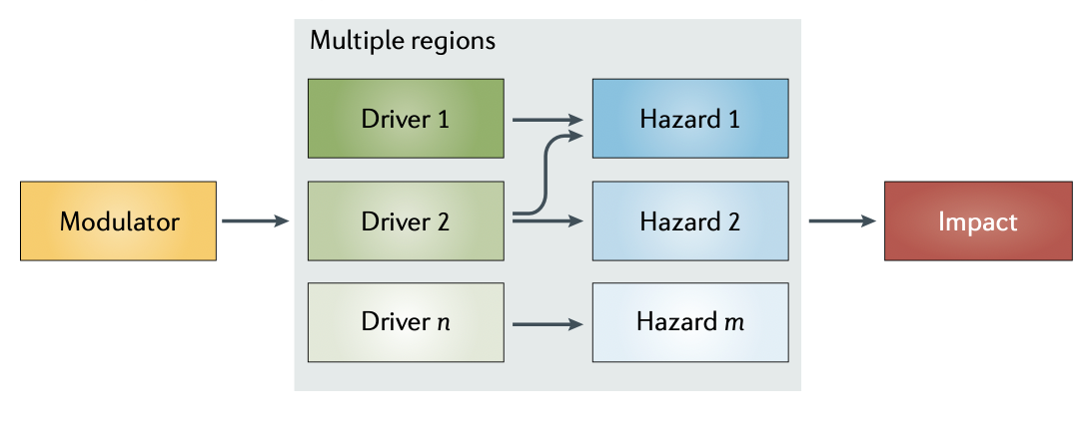
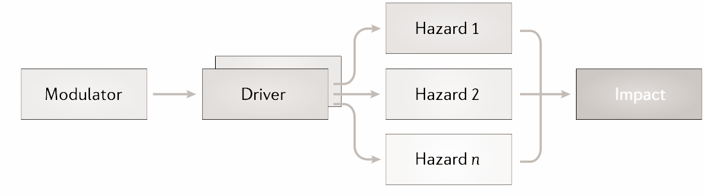
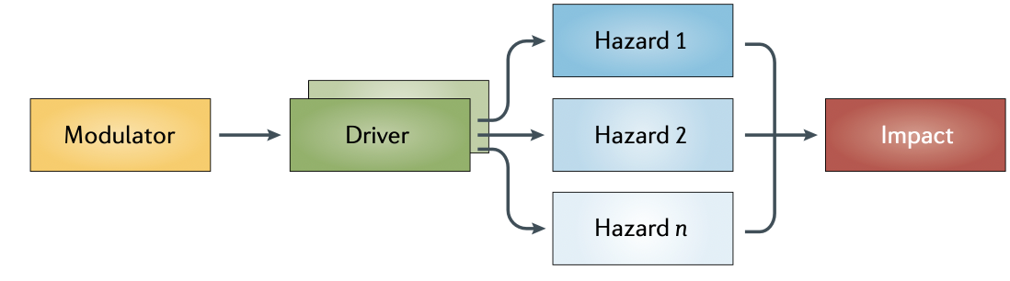
Compound Hazards When hazards intersect
Preconditioned
Temporal
Multivariate
Spatial
Zscheischler et al. (2020) A typology of compound weather and climate events

Slide 15
Compound Hazards When hazards intersect
Extreme rainfall in April-May
Caused landslides and flooding
181 dead
809⁺ injured
580,000 displaced
$3.7 billion damages
500,000 people without power or clean water
Flood defence deterioration and poor land-use policies contributed to damage extent
https://rapidmapping.emergency.copernicus.eu/EMSR720/reporting
Notes:
In April and May this year there was disastrous flooding in the south of Brazil
In the state’s capital, Porte Alegre, the average rainfall during the first twelve days of May was three times the monthly average
Leading to extreme flooding and landslides
There were widespread societal effects
181 casualties and over 809 injuries
Over 580,000 displaced
$3.7 billion in damages
500,000 people lost access to power or clean water
Govt criticised for extent of damages including
Neglect of flood defence infrastructure such as flood walls
Reducing funds for disaster risk management
Changing land-use policies to allow development of natural floodplains
Hazard modelling allows us to estimate what regions are at highest risk from climate hazards
For example, here is an Aqueduct global flood hazard map (in blue) for an area North of Porto Alegre
In this case, the map is okay, (river flood plain) however resolution is coarse
The better the hazard maps the better we can prepare for future possible climate hazards
------------------------------------------------------------------------------------------------------------------------------------------------------------------------
Description
In April and May this year there was disastrous flooding in the south of Brazil
the Brazilian State of Rio Grande do Sul was hit by extreme rainfall over a very short period
In the state’s capital, Porte Alegre, the average rainfall during the first twelve days of May was three times the monthly average
From the beginning of May the Guaíbi river in the State’s capital Porto Alegre was over 5m above its normal level
Area the size of northern France was flooded (check)
Landslides
Adaptation
Early warning systems worked and large humanitarian response including army, navy, firefighters, and police
Government neglect and policies blamed for extent of damages including
Intensive land use policies and building on floodable lands (9/04/2024)
Decrease in federal funds for risk management and disaster response R$7.8 billion in 2014 (inflation-adjusted) to R$2.6 billion in 2024.
In Porto Alegre, neglect was blamed for the rupture of one of the city flood wall’s gates, built to withstand 6m flooding but ruptured at 4.5m
More factors
Moist air travels South over the Amazon rainforest “The flying river”
Global warming ⇒ air can hold more moisture ⇒ heavier rains

Slide 16
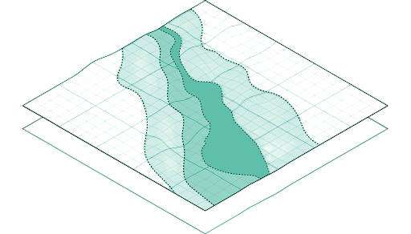
Mapping and Catastrophe Modelling Catastrophe model
Features
Portfolio of 1000s of events
Modelling is expensive
Numerical, stochastic, or hybrid simulations
Calculate statistics over losses from entire portfolio
Multivariate or region events

Slide 17
Mapping and Catastrophe Modelling Summary
Hazard maps
Catastrophe models
Format
One event map per return period
Thousands of possible event footprints
Memory and compute
Medium
High
Ease of use
High
Low
Compound events
No
Potentially
Calculate statistics
At every point
Over final losses
Notes:
2 columns with 3-4 points each

Slide 18
Deep Learning Applications

Slide 19
Introduction Relevance to ML researchers
Infeasible studies: limited by computational constraints
Infeasible studies: limited by computational constraints
Model sophistication
Less approximations made
Relationships accounted for
Feasible studies with ML
Feasible studies
Feasible studies
Model scale
Spatial range
Temporal range
Number of variables
Notes:
3 points
Intersections between industries: insurance / academia / govt
Work can contribute to better-informed climate adaptation policy
Work can highlight hotspots of vulnerability
Can guide investment
Plenty of knowledge gaps

Slide 20
Deep Learning Applications Key research directions
Before modelling
Parameterizing
Equation discovery
Modelling
Surrogates
Sub models
PINNs/hybrid models
After modelling
Bias correction
Downscaling
Bypass modelling
Event sampling
Model sophistication
Fewer approximations
Interdependencies
Feasible studies with ML
Model scale
Spatial scale
Temporal scale
Number of variables

Slide 21
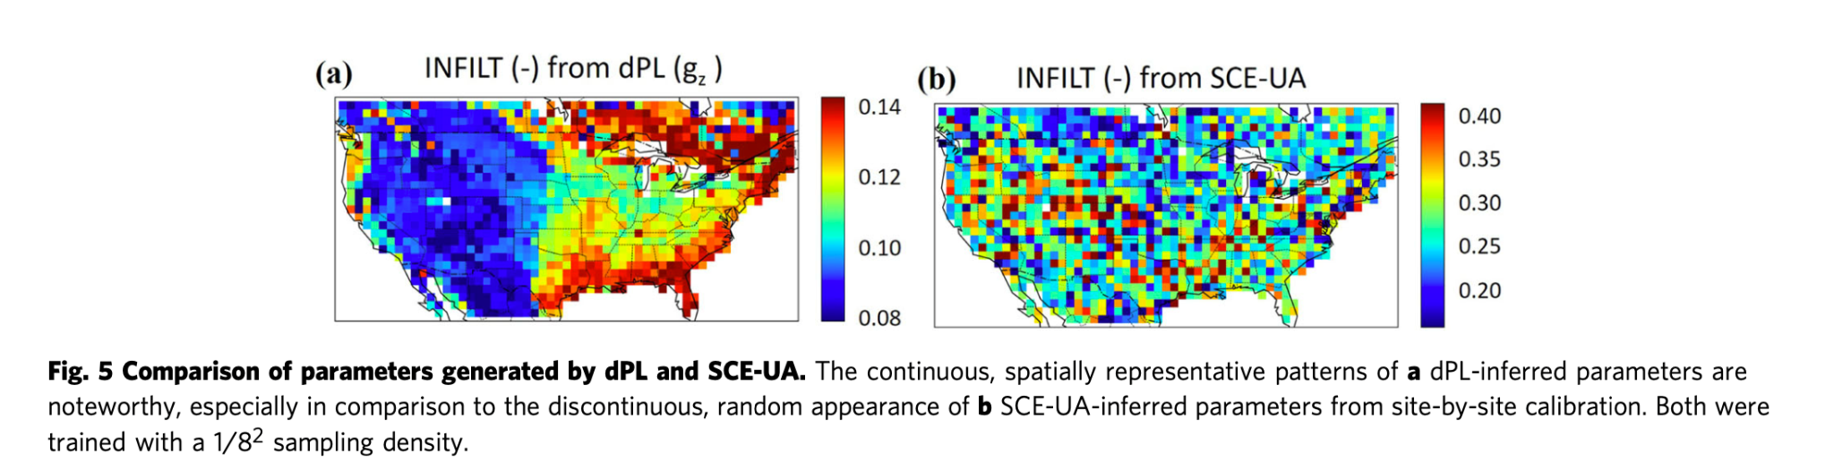
Deep Learning Applications Differentiable parameter learning (dPL)
LSTM Surrogate hydrological model
gradient tracking
Optimise for parameters which minimise model error
Better physical coherence
Improves data scaling
Outperforms in classic methods
Soil moisture and streamflow
Tsai, W. P., Feng, D., Pan, M., Beck, H., Lawson, K., Yang, Y., ... & Shen, C. (2021). From calibration to parameter learning: Harnessing the scaling effects of big data in geoscientific modeling. Nature communications, 12(1), 5988.
Notes:
Only do 1 or 2

Slide 22
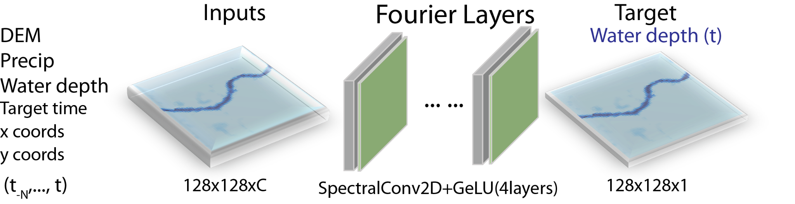

Deep Learning Applications FNO flood model
Efficient
Zero-shot resolution - learns in Fourier space
Doesn’t need to be retrained for parameter changes
Sun, A. Y., Li, Z., Lee, W., Huang, Q., Scanlon, B. R., & Dawson, C. (2023). Rapid flood inundation forecast using Fourier neural operator. In Proceedings of the IEEE/CVF International Conference on Computer Vision (pp. 3733-3739)
Notes:
Only do 1 or 2

Slide 23
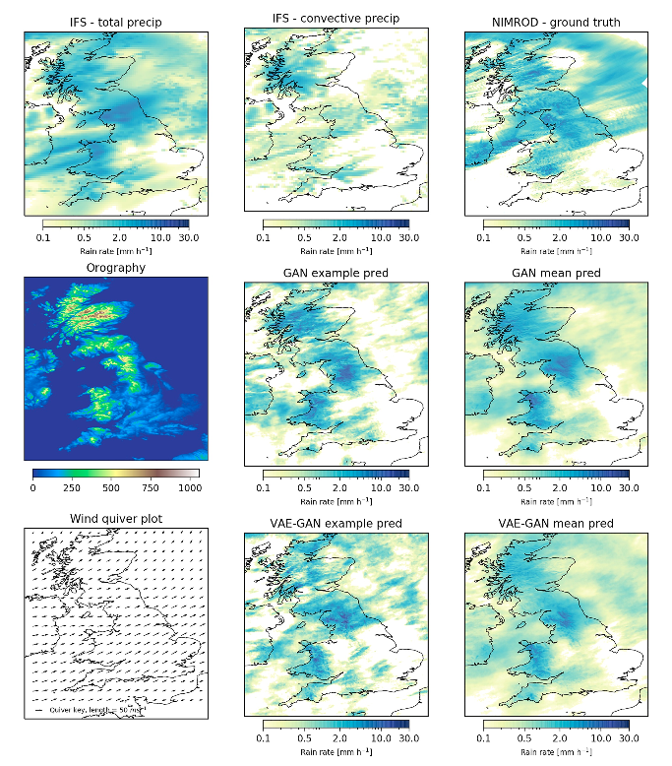
Deep Learning Applications Post-processing precipitation forecasts
Conditional GAN
Condition on forecast and related variable (orography)
Downscale to higher resolution
Harris, L., McRae, A. T., Chantry, M., Dueben, P. D., & Palmer, T. N. (2022). A generative deep learning approach to stochastic downscaling of precipitation forecasts. Journal of Advances in Modeling Earth Systems, 14(10), e2022MS003120.
Notes:
Only do 1 or 2

Slide 24
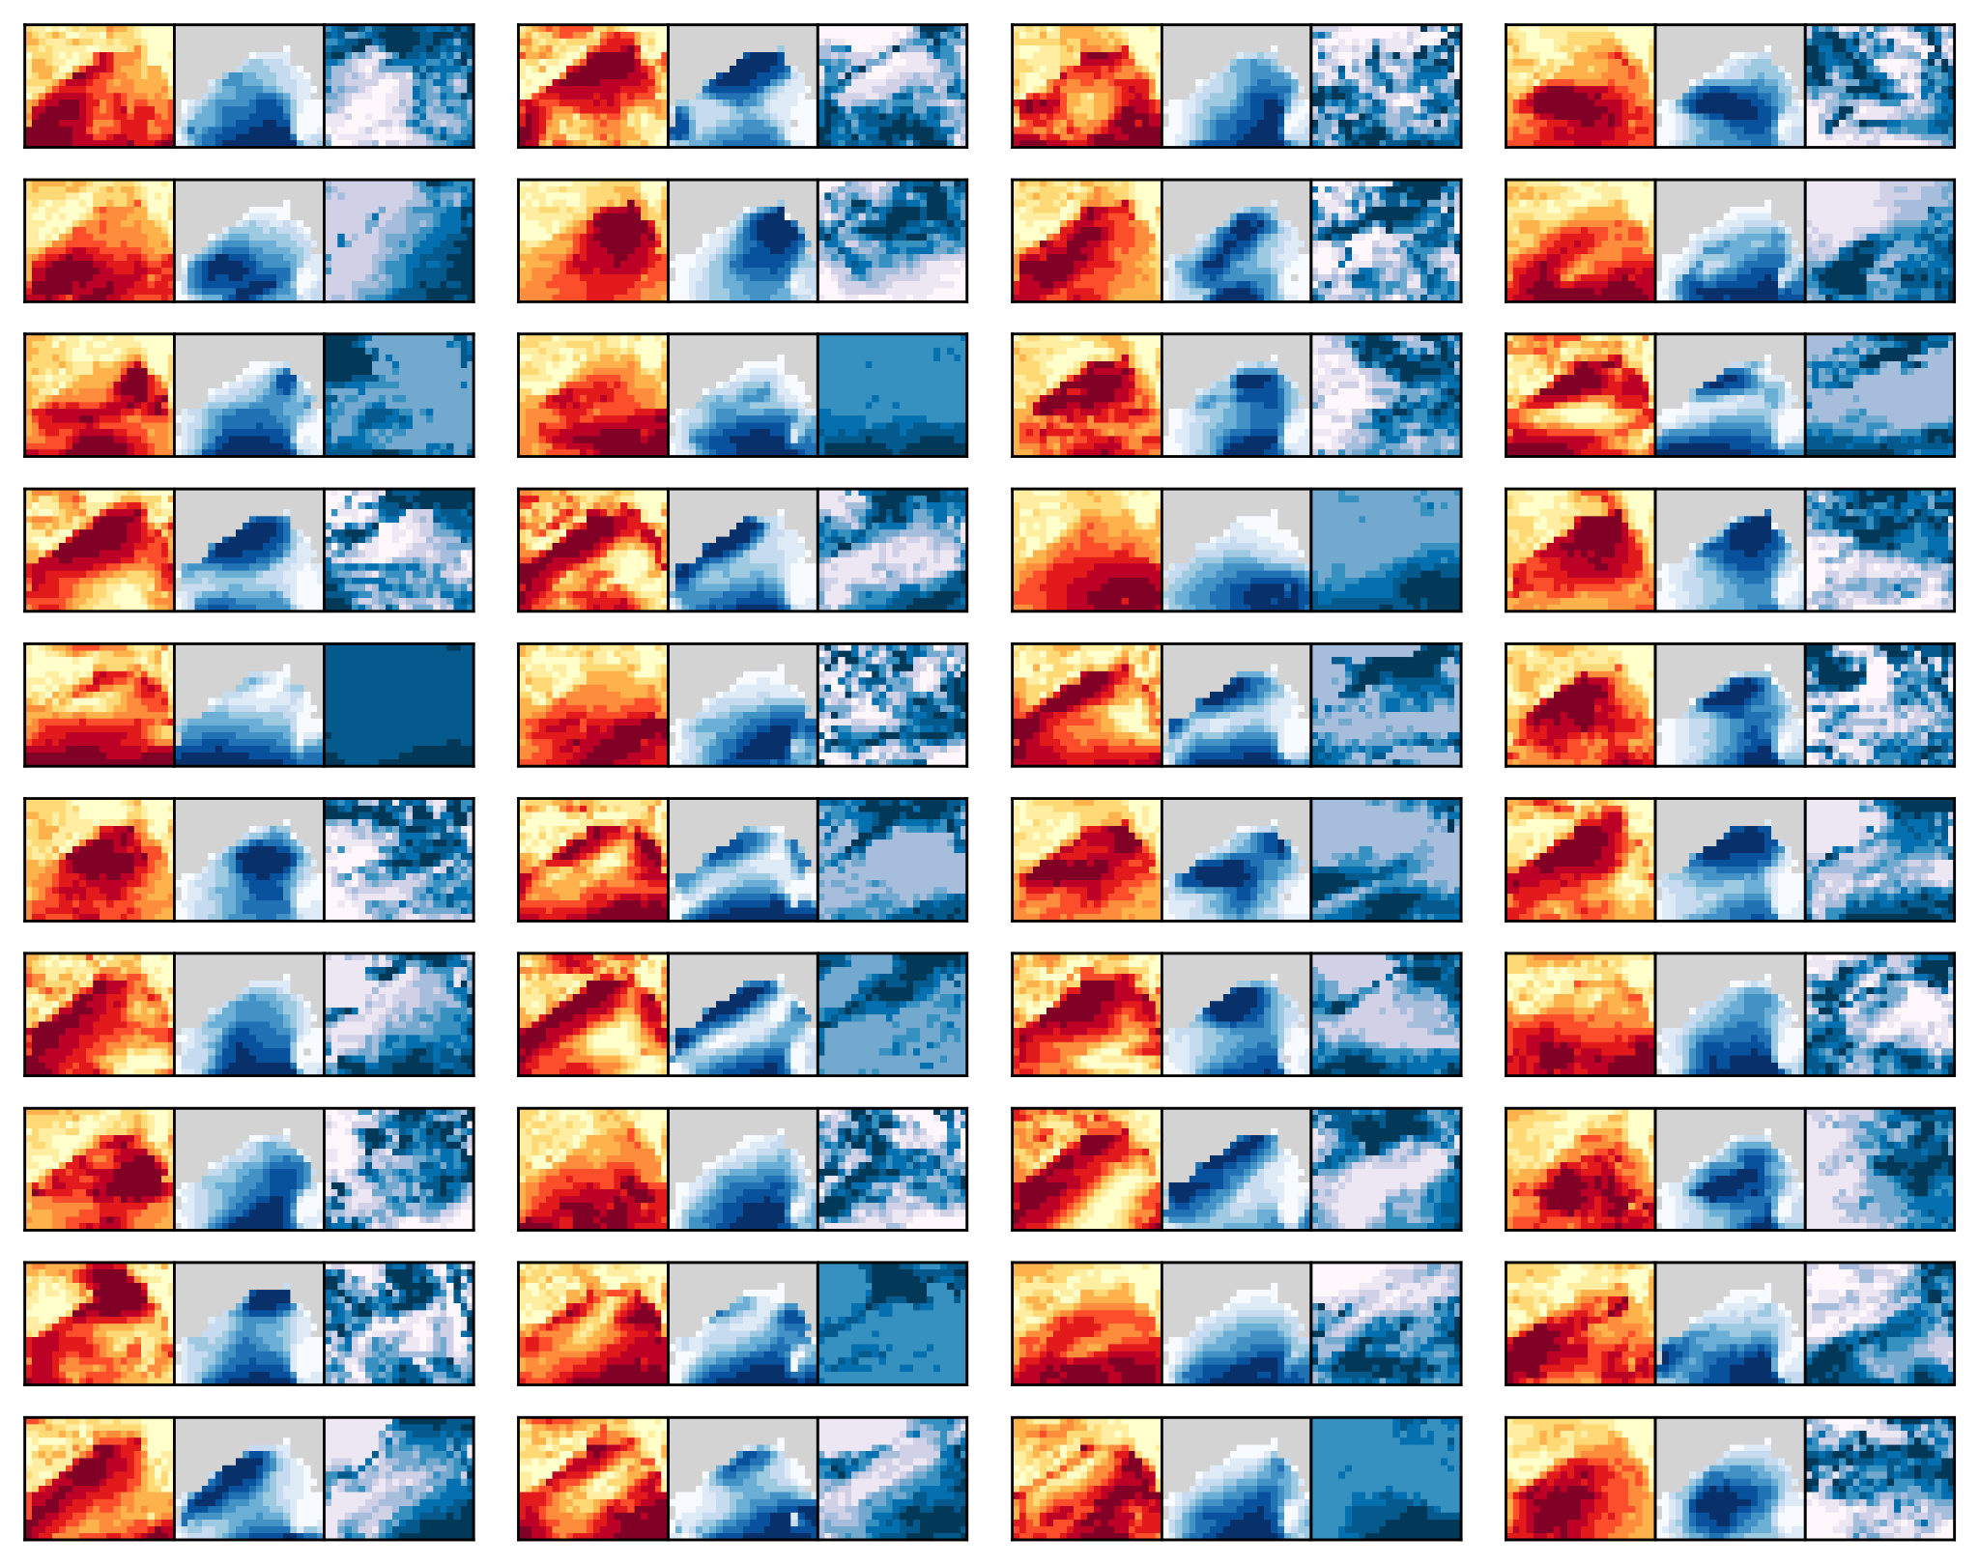
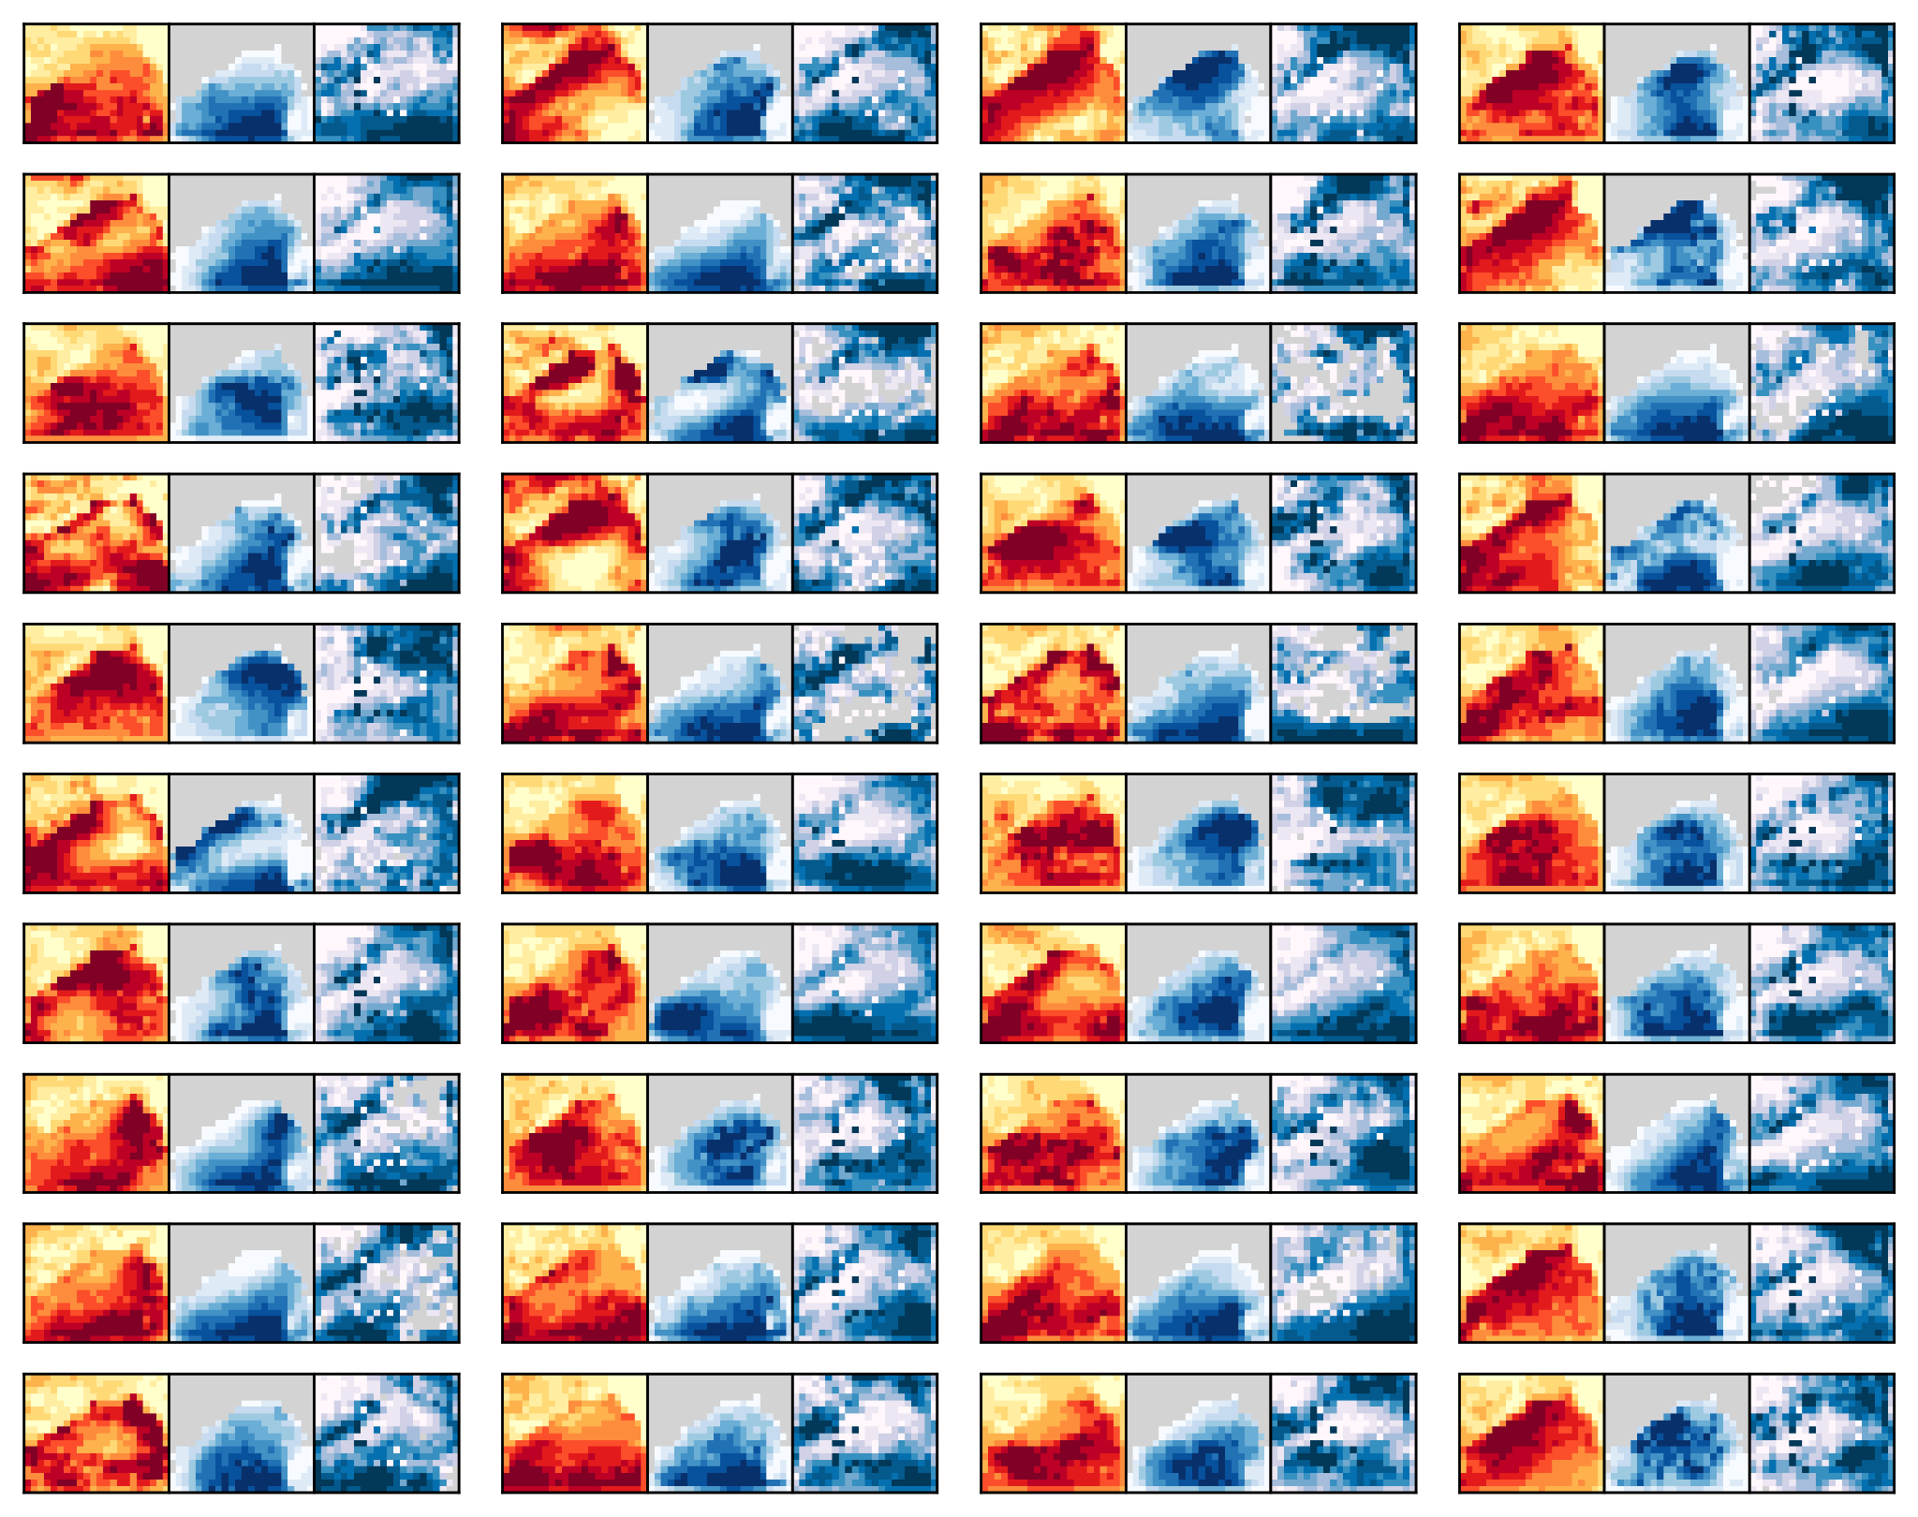
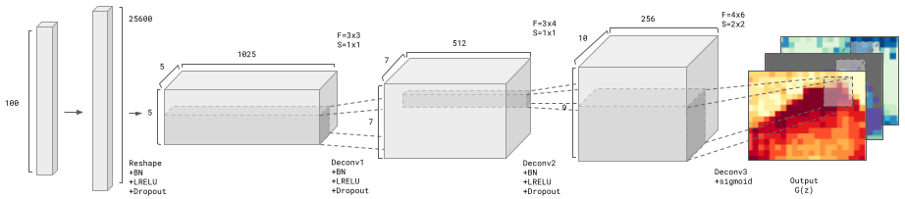
Deep Learning Applications Event sampling
Training data
Generated samples
Peard, A., & Hall, J. (2023). Combining deep generative models with extreme value theory for synthetic hazard simulation: a multivariate and spatially coherent approach. arXiv preprint arXiv:2311.18521.
Notes:
Only do 1 or 2

Slide 25
Conclusion and Future Directions

Slide 26
Conclusion and Future Directions Recap
Hazard modelling generates actionable insights
Two main types of hazard modelling
Probabilistic hazard maps
Cat (event-based) modelling
ML can increase scale and complexity of hazard modelling
Compound events
Larger scales
Higher resolution
Many interesting areas for improvement
Notes:
Hazard modelling generates actionable insights to be used by stakeholders. E.g., financial/social losses
Two main types of hazard modelling
probabilistic hazard maps
cat (event-based) modelling
ML can increase scale and complexity of events modelled, capturing compound events and larger scales in more detail
Many gaps and areas for ML

Slide 27
Thanks for listening!

Slide 28
Further Resources
Machine learning for hazard modelling
Reichstein et al. (2019) Deep learning and process understanding for data-driven Earth system science
Hazard modelling typology
Fathom website

Slide 29
Deep Learning Applications Challenges for ML researchers
(Generally) Improve scale-complexity trade-off
Improve base models of climate drivers / hazards
Parameterization
ML sub models
Post-processing: bias-correction, downscaling
Surrogate modelling
Improve sampling / distribution learning
Improve fragility functions (equation discovery)
Data generation: e.g., from satellite imagery
Other!
Reichenstein classic issues:
Interpretability & uncertainty => propagate into loss estimates
Physical consistency
Limit labels
Complex and uncertain data
Compute
Convergence

Slide 30
Conclusion and Future Directions Open problems and opportunities
Compound hazard modelling
Preconditioning
Temporal
Surrogates

Slide 31
Deep Learning Applications Examples
ESLs along coastlines
Semanova – epidemiology
Harris (2022) – downscaling
Boulaguiem – heat and precip
My work – multivariate & spatial hazards
Notes:
Only do 1 or 2

Slide 32
Mapping and Catastrophe Modelling Current technical challenges
Compound events
Preconditioned
Temporally-compounding
Spatially-compounding
Multivariate - e.g., SFINCS
Scale-complexity trade-off
Computation
Memory requirements
E.g., waves from mangrove example, wave length rarely modelled in risk studies (specially at large scales)
Ease of use/accessibility
Uncertainty and communication

